Slide 1



Is Just-in-Time really the most profitable supply chain strategy for Nike in an uncertain world?
15.093 Optimization Methods – Final Project
Team Members: Jason Jia, Virginia Maguire

Slide 2
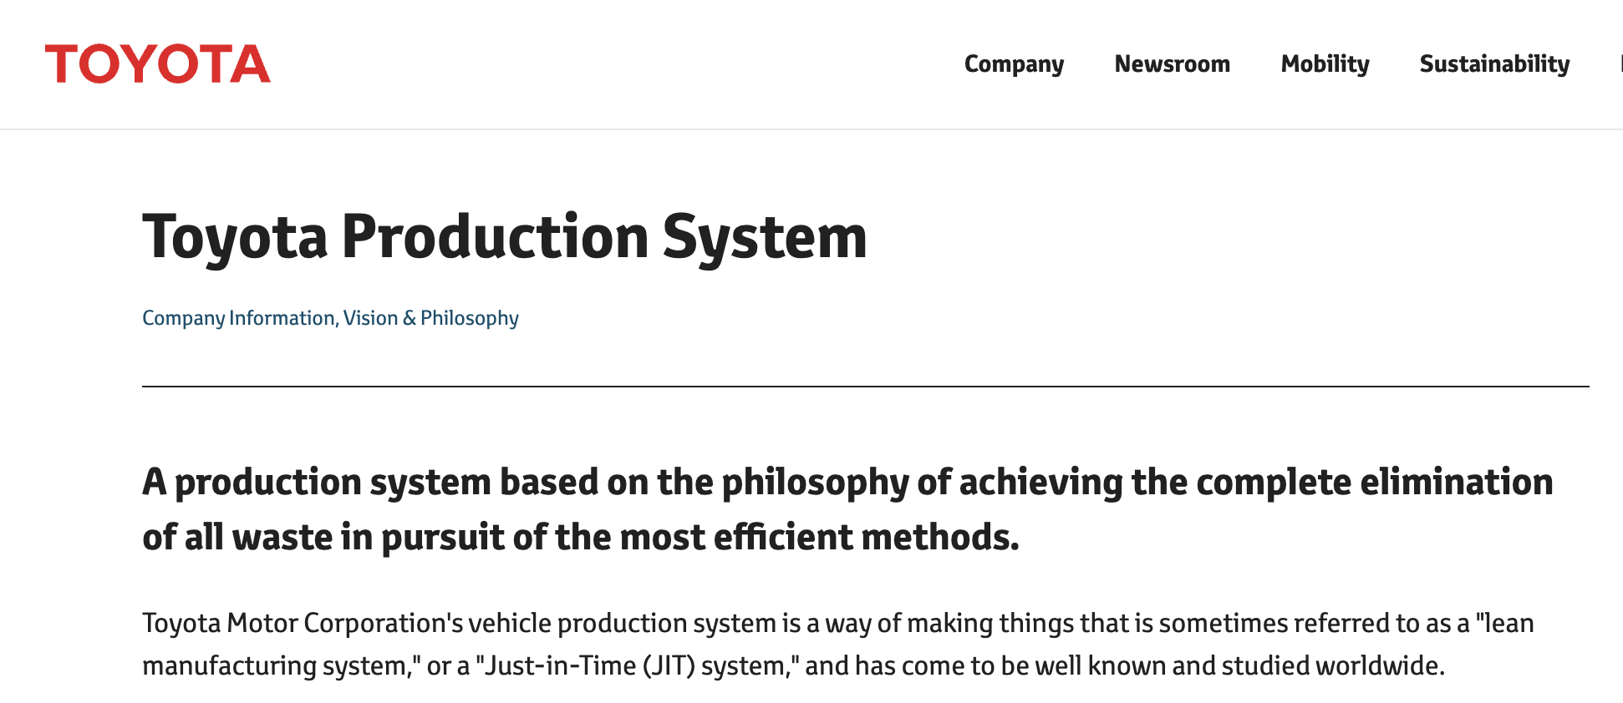
Problem and motivation Before Covid-19, businesses focused on perfecting a Just-in-Time (JIT) system to maximize profits.

Slide 3
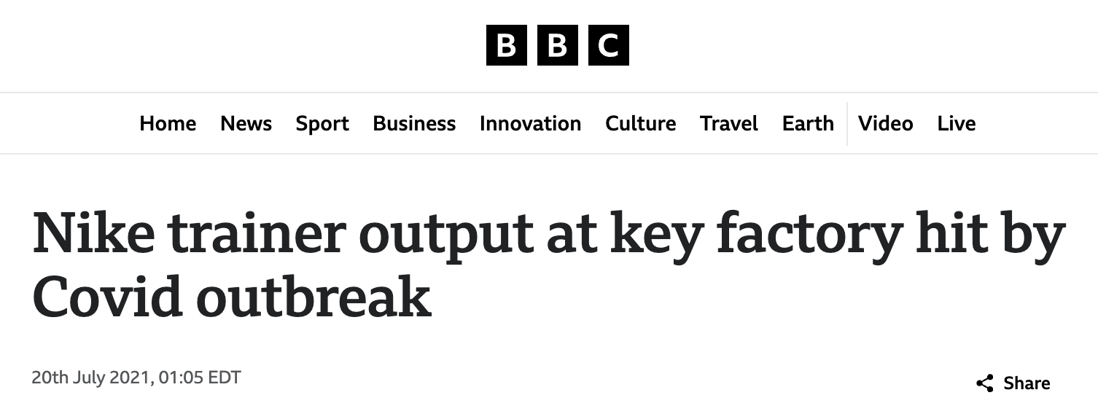
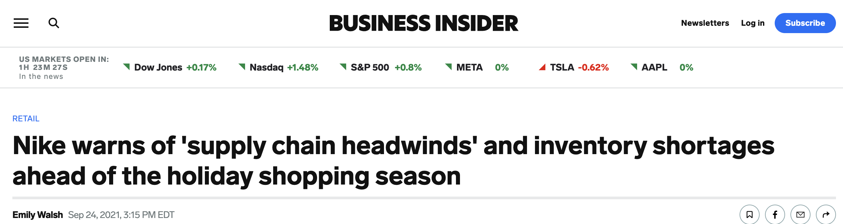
Problem and motivation But Covid-19 caused massive supply chain disruptions and resulted in businesses being unable to fulfil demand.

Slide 4
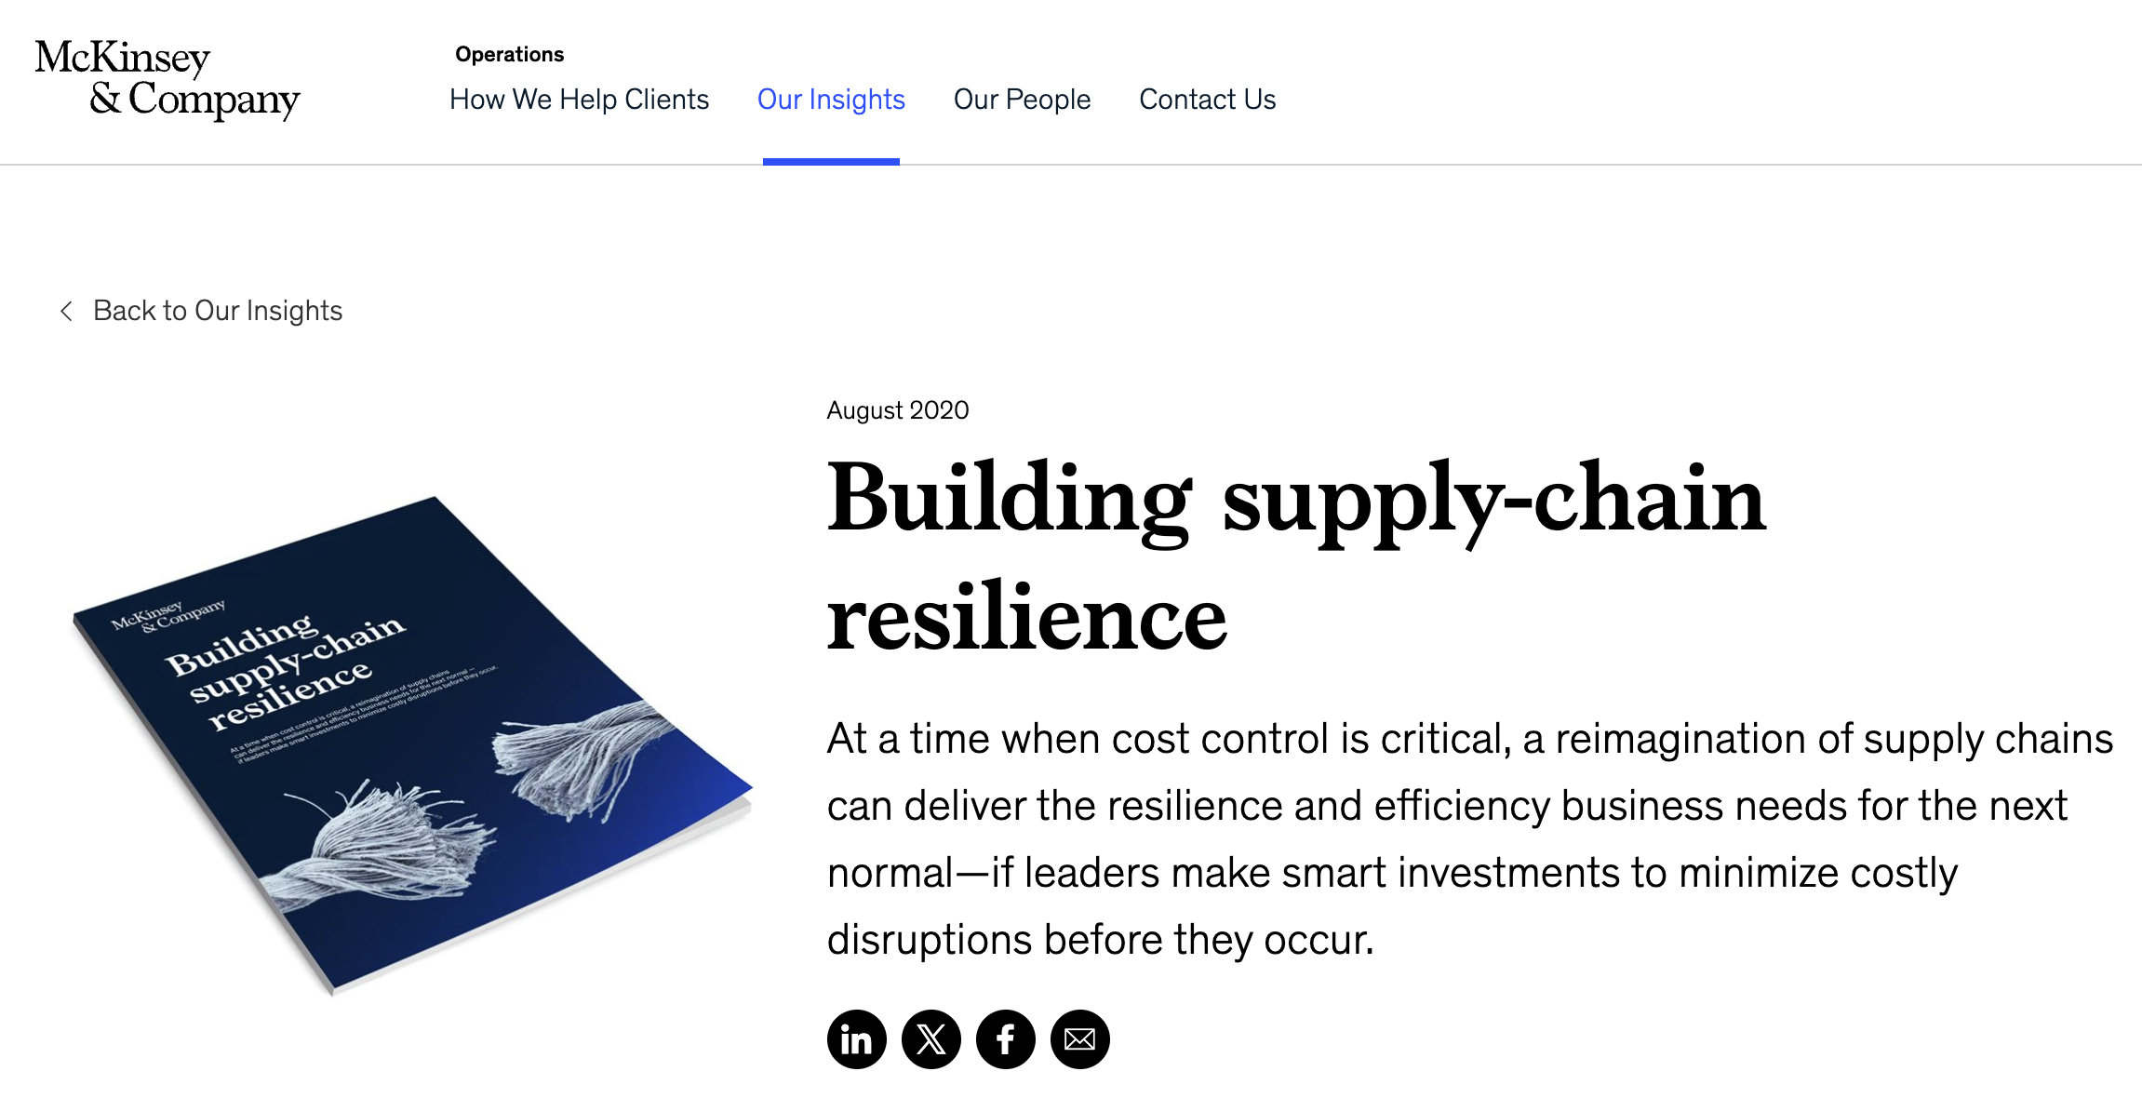
Problem and motivation This contributed to McKinsey, Bain and BCG recommending businesses to build a more resilient and robust supply chain.

Slide 5
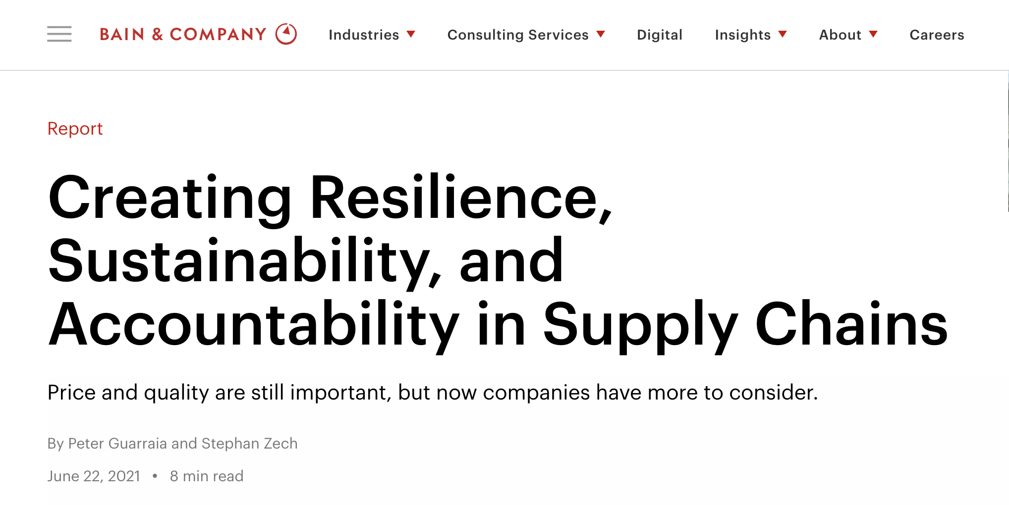
Problem and motivation This contributed to McKinsey, Bain and BCG recommending businesses to build a more resilient and robust supply chain.

Slide 6
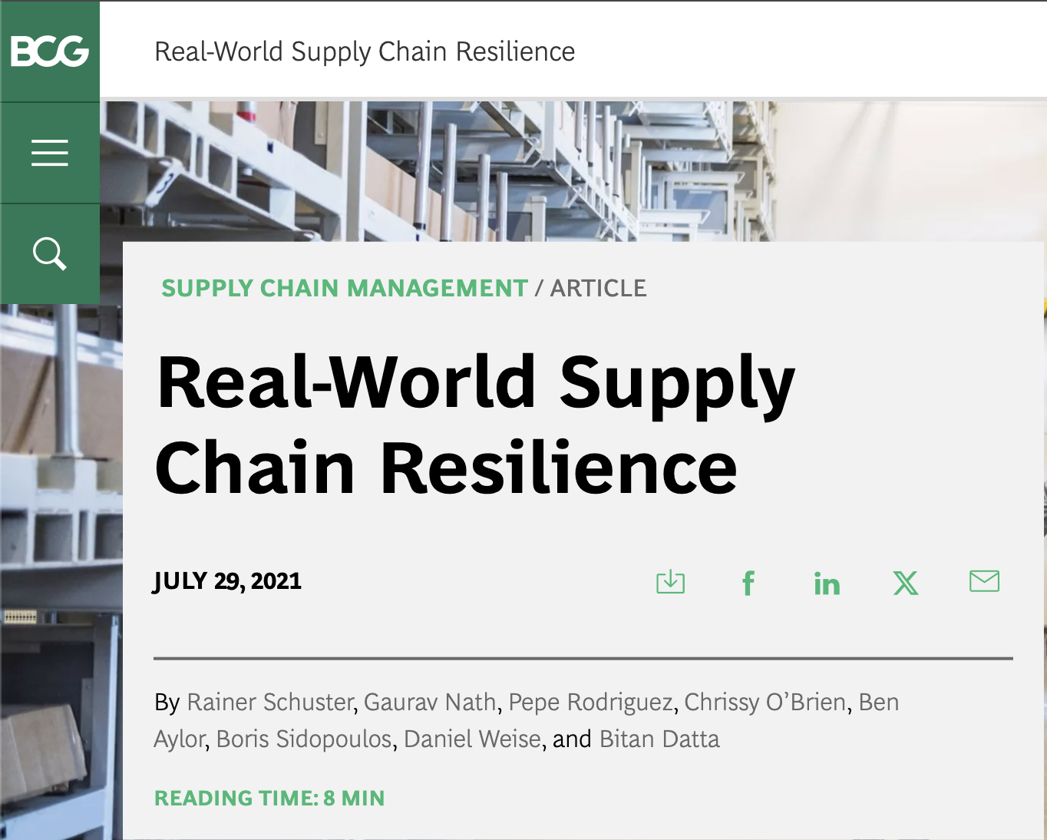
Problem and motivation This contributed to McKinsey, Bain and BCG recommending businesses to build a more resilient and robust supply chain.

Slide 7
Problem and motivation But there is no publicly available research quantifying the potential profitability improvements under different conditions.
To what extent do supply disruptions (modelled by ε) and penalties for unmet demand (modelled by ⍺) affect the differentially robust supply chain strategies for Nike (modelled by 𝛿), in terms of profit, inventory levels and concentration of suppliers?

Slide 8
DATA We collected data from multiple sources and combined them with simplifying assumptions.
Nike Manufacturing Map (Factory Worker Data)
10-K Statements
Drewry World Container Index
Number of employees in each factory and what the factory produces
Aggregated to regional level
Estimate workers over time as we assume 5% annual growth in labor
Allows us to estimate the number of products that can be produced in the region
Pulled revenues, cost of sales, and inventory costs for each reported region and product
Focused on shoes
Allowed us to estimate:
Shoes sold (Demand)
Inventory holding cost
Marginal cost of producing shoes in each region
Has shipping cost data
Simplified to the average cost to ship between producer regions and consumer regions

Slide 9
Optimization Problem Objective: Maximize Net Profit
Decision Variables
Formulation
Constraints
Primary Decision Variable: Quantity of shoes to produce in each region I at time t (X_{it})
Secondary Decision Variables
Quantity of shoes to ship for producer region i to consumer region j at time t (S_{ijt})
Holding inventory in producer region i at time t (E_{it})
Unmet demand in consumer region j at time t (M_{jt})
Net Revenue: S_{ijt} produces net revenue of consumer price to purchase shoes (p_{t}) minus the transit cost (T_{ijt} )
Costs
C_{it} X_{it} is the cost incurred to produce shoes in region i at time t
H_{t}E_{it} is the inventory holding cost in region i at time t
αp_{t}M_{jt} is the cost of not meeting demand in region j at time t (where α is a parameter to tune)
No starting inventory (E_{i0} = 0)
Production in a region can't surpass labor availability
The supply in a consumer region can't surpass it's demand
Unmet demand is the difference between demand and supply to the consumer region
Supply is a function of production and inventory

Slide 10
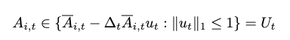
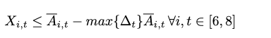
Introducing Uncertainty to labor availability
We assume labor availability is fixed for 2016-2020, however there will be some shock that reduces availability by Δ in 2021-2023
So availability in 2021-2023 is:
After some manipulation this simplifies to:
Where Ã_{it} is the known availability
Δ_{t} is a vector of 10 random numbers that range from 0-
We test various

Slide 11
Methods
Run the model for given α and protecting against availability reductions up to
Evaluate the model when the actual reduction in availability ε is known for 2021-2023
Re-run the model for 2021-2023 only
Provide production and inventory levels for 2020 to the model as initial values
Obtain net profit and decision variables for 2021-2023
Compare the net profit under various strategies:
For 2020, we compare regional Herfindahl (supplier concentration index which is a measure of inventory levels) across various strategies.

Slide 12
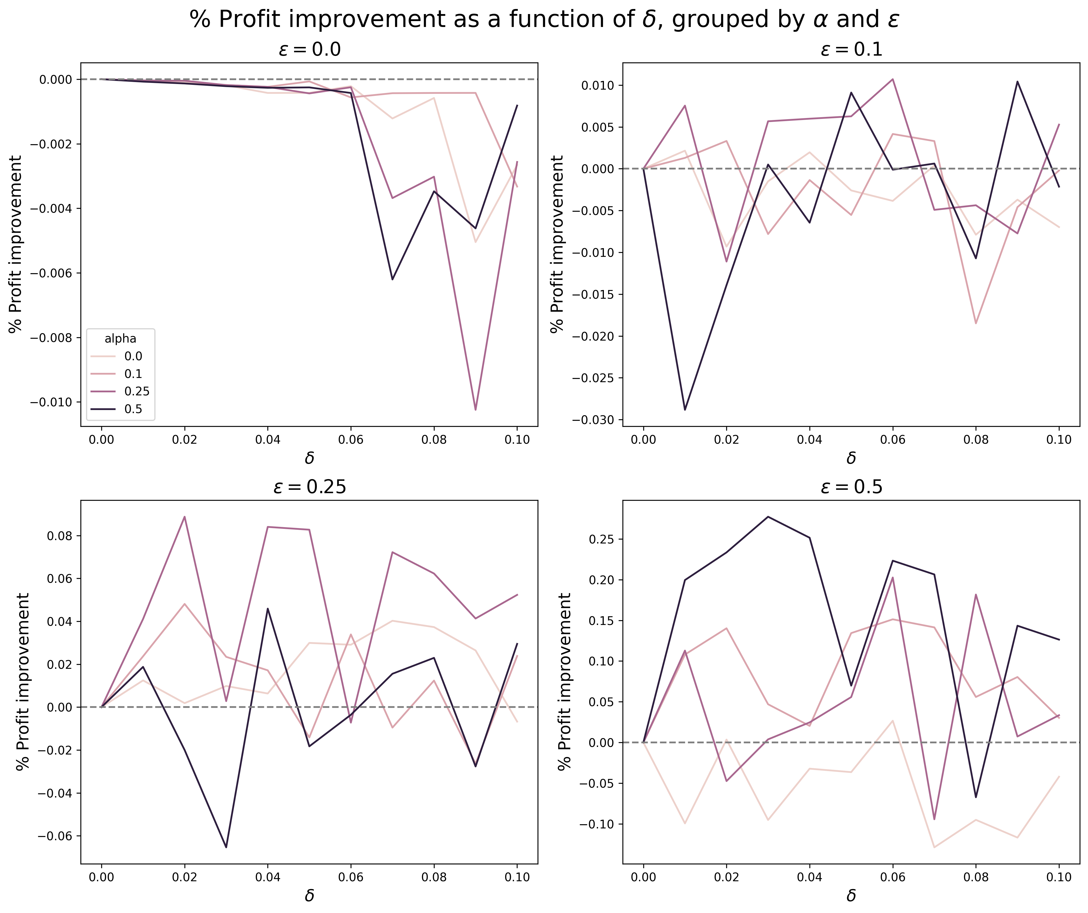
Key findings (1/3) A robust supply chain is more profitable than a non-robust one.
With unexpected supply chain disruptions ε > 0, a somewhat robust strategy almost always performs better than a non-robust strategy.
As ε increases, the percentage profit improvement of a δ-robust strategy compared to a non-robust strategy (δ = 0) tends to be increasingly positive.

Slide 13
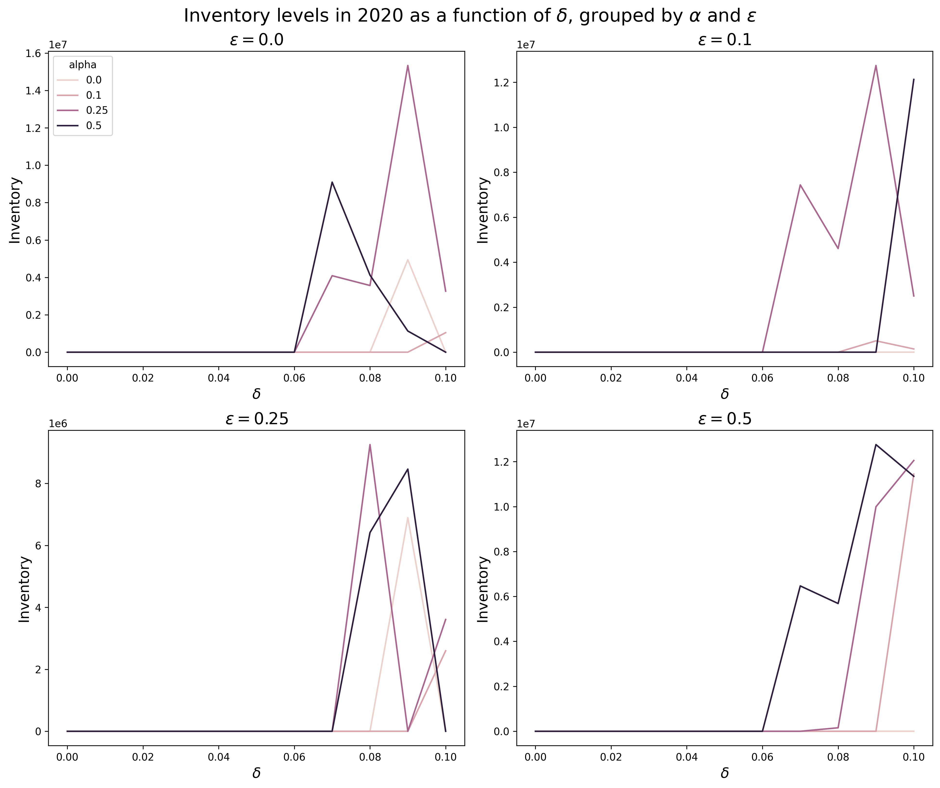
Key findings (2/3) A robust supply chain has higher inventory levels.
Inventory levels right before Covid-19 rise as Nike's supply chain strategy becomes more robust, up to a point.

Slide 14
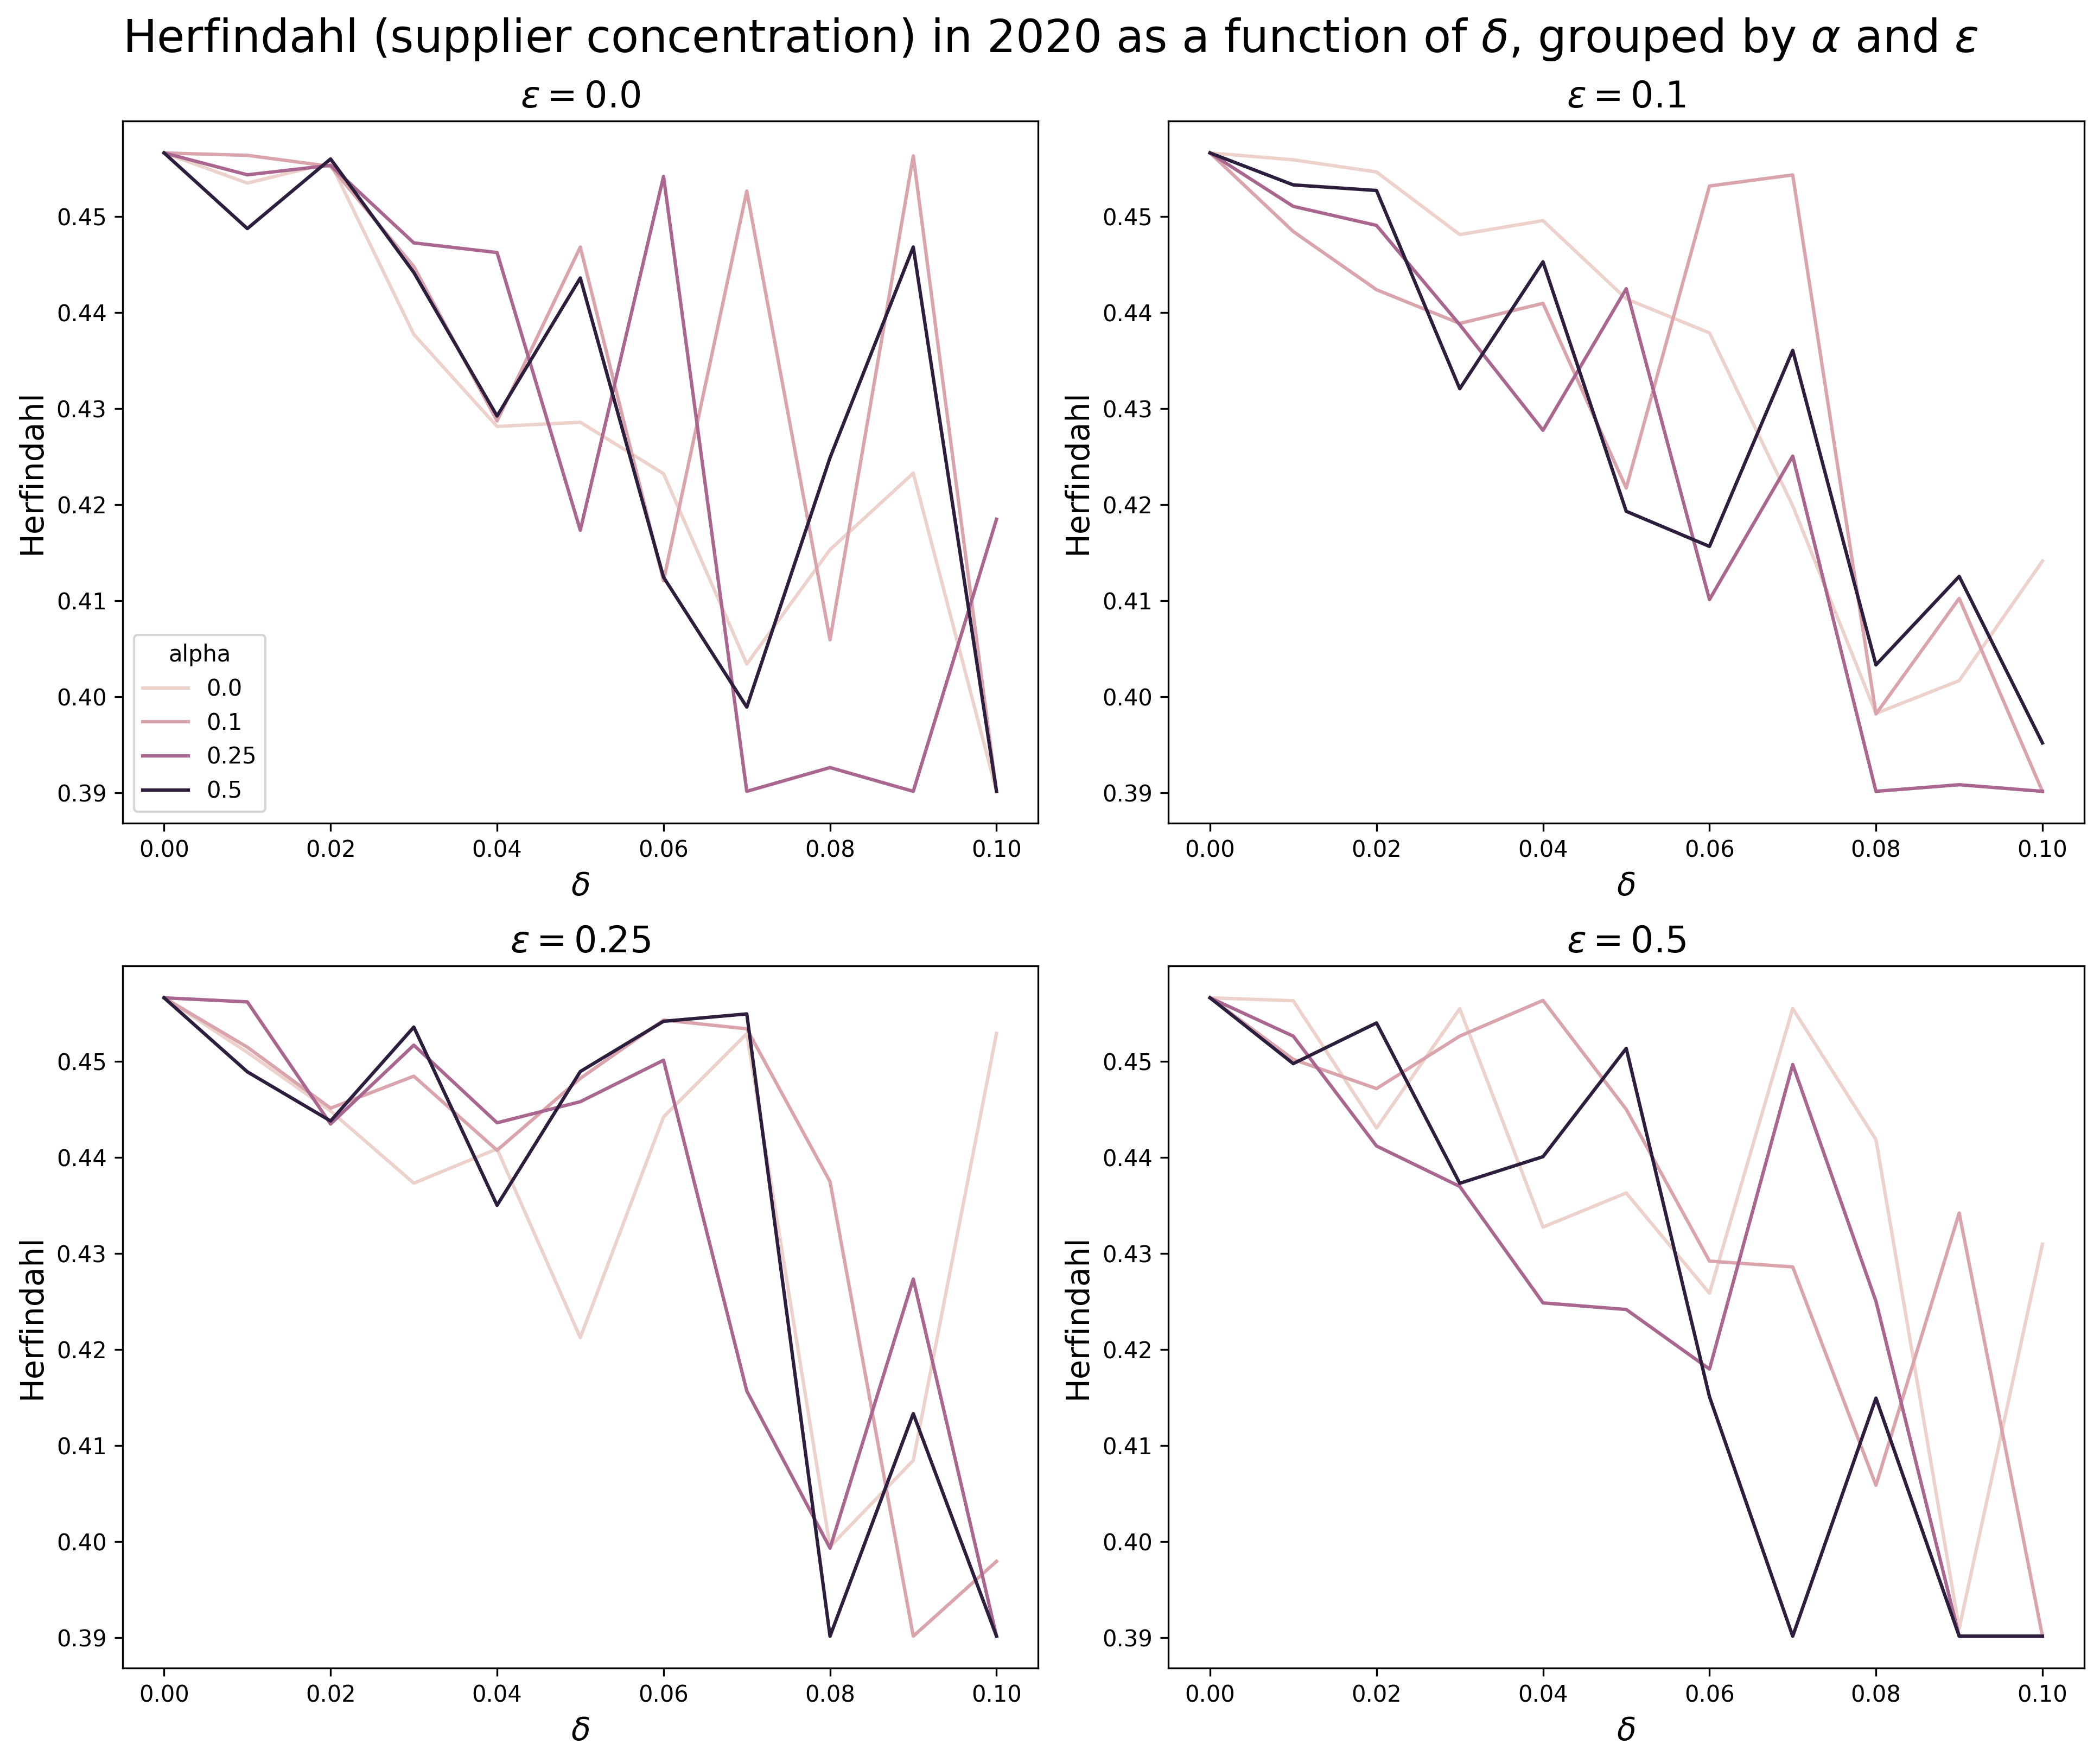
Key findings (3/3) A robust supply chain has lower supplier concentration.
Herfindahls (a measure of supplier concentration) right before Covid-19 decrease as Nike's supply chain strategy becomes more robust, up to a point.
This points to regionalization, a strategy to pursue greater supplier diversification at a regional level.

Slide 15
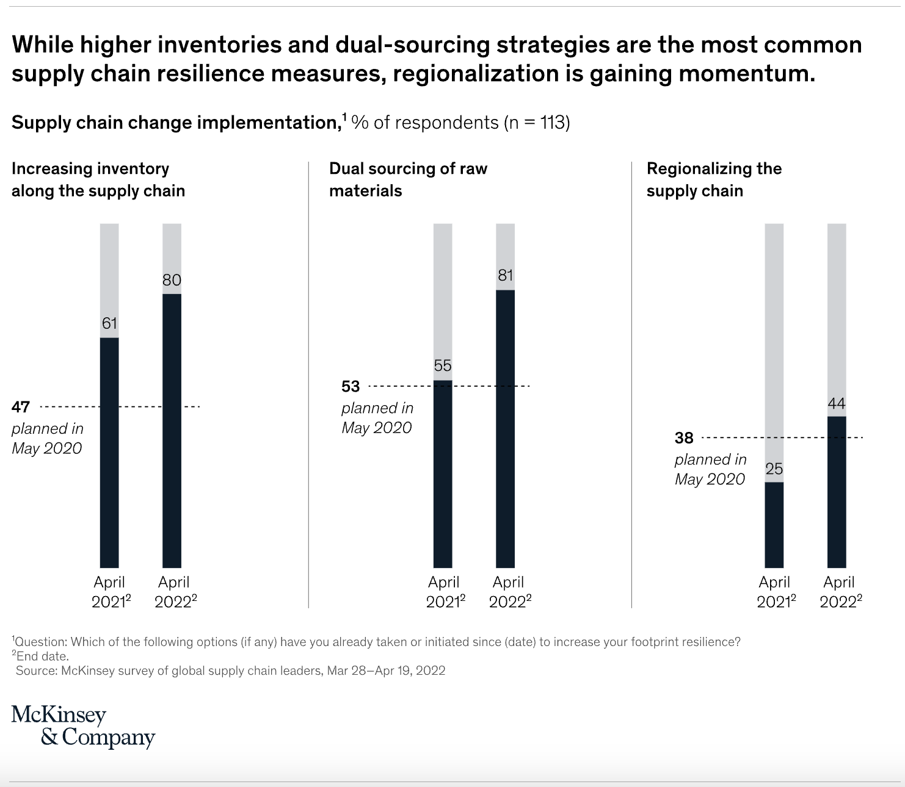
impact Businesses still adopting a JIT model should take immediate supply chain resilience to avoid being edged out by competitors.

